Slide 1
Availability-Aware Service Provisioning with Backup Sub-chain-enabled Sharing
Yuncan Zhang, Fujun He, and Eiji Oki
Presenter: Congzhou Li

Slide 2
Abstract
This paper proposes an availability-aware service provisioning model with backup sub-chain-enabled sharing in network function virtualization to minimize the deployment cost.
A sub-chain consists of a set of ordered VNFs that corresponds to a part of or the whole function chain of a service. Different from a conventional model in which a backup sub-chain is dedicated to protecting a primary sub-chain of one service, the proposed model allows the backup sub-chain sharing among services to reduce the deployment cost.
A heuristic is designed to tackle it. The results show that the proposed model achieves lower deployment cost with satisfying the availability requirement than the conventional one.

Slide 3
Contents
Introduction
Network Model
Shared Protection Example
Proposed Model
Heuristic Solution
Numerical Result

Slide 4
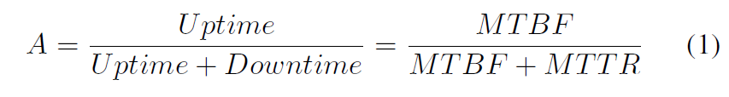
Introduction
Availability is a key performance indicator in measuring the service quality in the network.
The availability of a VNF can be expressed using uptime followed by downtime, which can be characterized in terms of Mean Time Between Failures (MTBF) and Mean Time To Repair (MTTR), respectively.
The availability of a function in an SFC is related
to the availabilities of both VNF and physical node hosting the VNF.

Slide 5
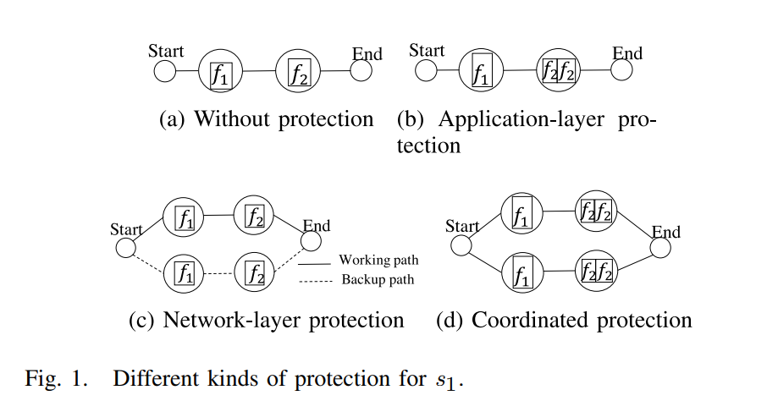
Introduction
Previous work: A service chain provisioning approach with sub-chain-enabled coordinated (SCEC) protection to satisfy availability requirements
A sub-chain consists of a set of ordered VNFs that
correspond to a part of or the whole function chain of a service.

Slide 6
Introduction
A question arises:
How can we decide the processing order of VNFs for each service to facilitate the backup sub-chain sharing and decide the deployment of VNFs and the path through the VNFs in the SN to minimize the deployment cost with satisfying the required availability?

Slide 7
Introduction
Contribution:
In this paper, we propose an availability-aware service provisioning model with backup sub-chain-enabled sharing in NFV.
A sub-chain consists of a set of ordered VNFs that correspond to a part of or the whole function chain of a service.
The proposed model allows the backup sub-chain sharing among services to reduce the deployment cost with satisfying the required availability.

Slide 8
Network Model
An Substrate Network (SN) consists of a set of nodes, and a set of directed links. Generally, the network nodes include:
Facility nodes: hold computing capacity to provide functionality,
Networking nodes: for communication between devices such as routers and switches, and other specialized hosts. This paper considers that each facility node is connected to the network via a router or switch
This paper focuses on the failures of facility nodes while the routers and switches are assumed not to fail.

Slide 9
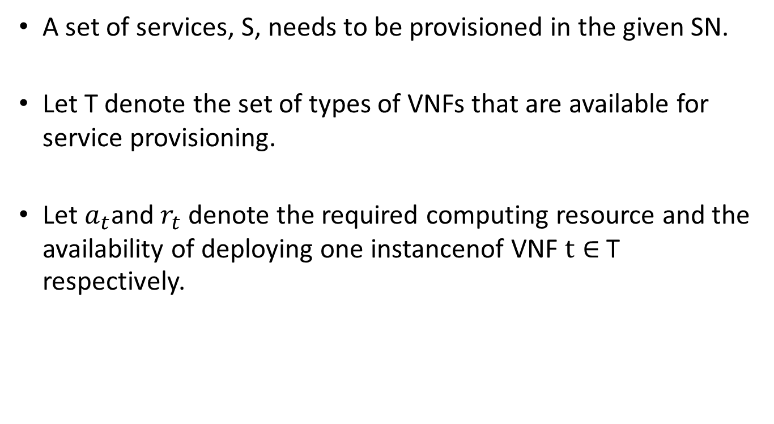
Network Model
A set of services, S, needs to be provisioned in the given SN.
Let T denote the set of types of VNFs that are available for service provisioning.
Let $a_{t}$and $r_{t}$ denote the required computing resource and the availability of deploying one instancenof VNF $t∈$ T respectively.

Slide 10
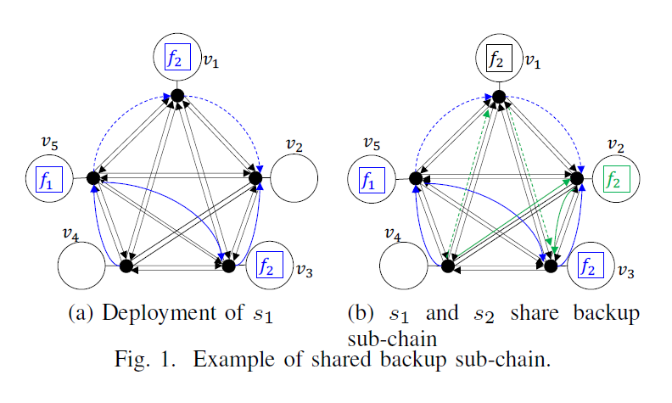
Shared Protection Example
SCSE protection:
0.946

Slide 11
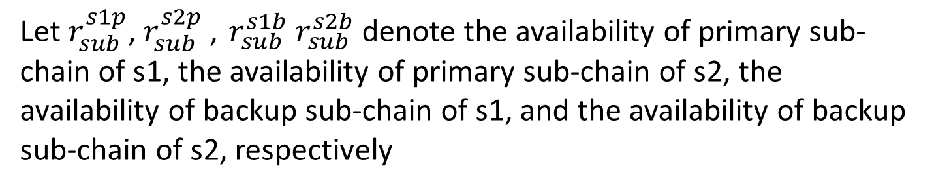
Shared Protection Example
Let $r_{sub}^{s1p}$, $r_{sub}^{s2p}$, $r_{sub}^{s1b} r_{sub}^{s2b}$denote the availability of primary sub-chain of s1, the availability of primary sub-chain of s2, the availability of backup sub-chain of s1, and the availability of backup sub-chain of s2, respectively

Slide 12
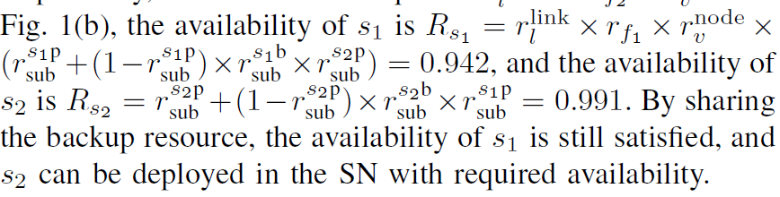
Shared Protection Example

Slide 13
Proposed Model
Model description:
In SCEC protection, VNFs are cut into blocks:
If the working sub-chain in a block is protected by the backup sub-chain, we call such a block a parallel block. The proposed model allows parallel blocks of services to share the backup sub-chain.
Otherwise, only the working sub-chain is provided in a block, and we call such a block a serial block

Slide 14
Proposed Model
Model description:
In SCEC protection, VNFs are cut into blocks:
If the working sub-chain in a block is protected by the backup sub-chain, we call such a block a parallel block. The proposed model allows parallel blocks of services to share the backup sub-chain.
Otherwise, only the working sub-chain is provided in a block, and we call such a block a serial block
The logical forwarding graph of VNFs are determined in this way.

Slide 15
Proposed Model
In addition to the above decisions that determine the VNF forwarding graph, we need to determine the deployment of VNFs and the routing path to pass through them in the SN.
To guarantee the availabilities of services sharing a backup sub-chain, the deployment of the shared backup sub-chain and corresponding primary sub-chains needs to be considered carefully. Such as :
Transmission capacity constraint
Avoid the correlated failures constraint
The proposed model aims to minimize the deployment cost of services with satisfying the availability requirement

Slide 16
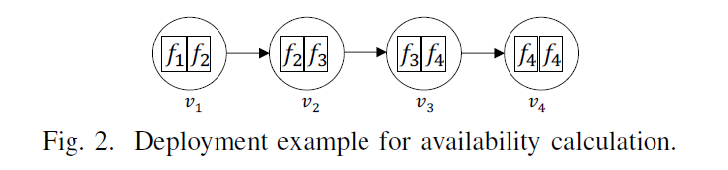


Proposed Model
Availability calculation:

Slide 17
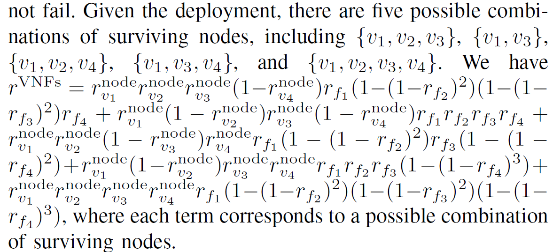
Proposed Model
Availability calculation:

Slide 18
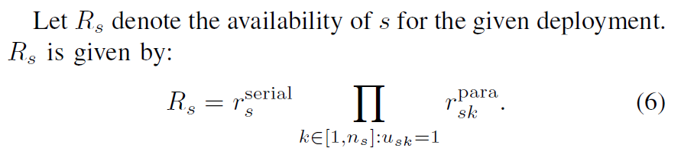
Proposed Model
Availability calculation:
We describe the general method of availability calculation
for services with given deployment. With SCEC protection, the
VNFs of a service are divided into different blocks including
serial blocks and parallel blocks.

Slide 19
Proposed Model
Problem Complexity:
Theorem 1. Given a set of services with relative processing orders of VNFs and an SN, the problem of availability guaranteed service provisioning with the SCEC protection and backup sub-chain sharing to minimize the deployment cost is NP-hard.

Slide 20
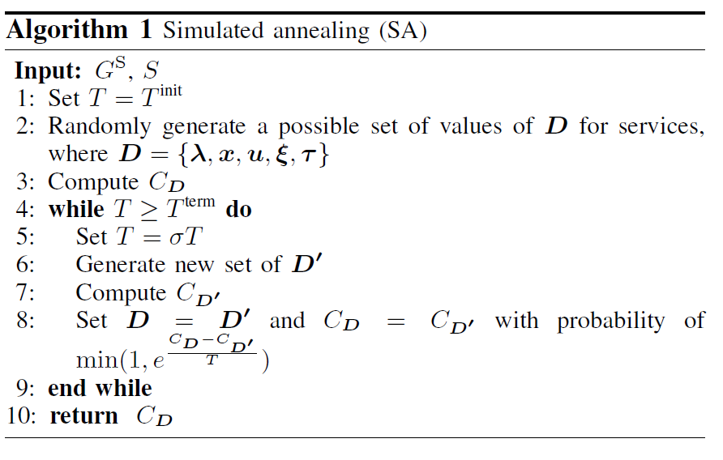
Heuristic Solution

Slide 21
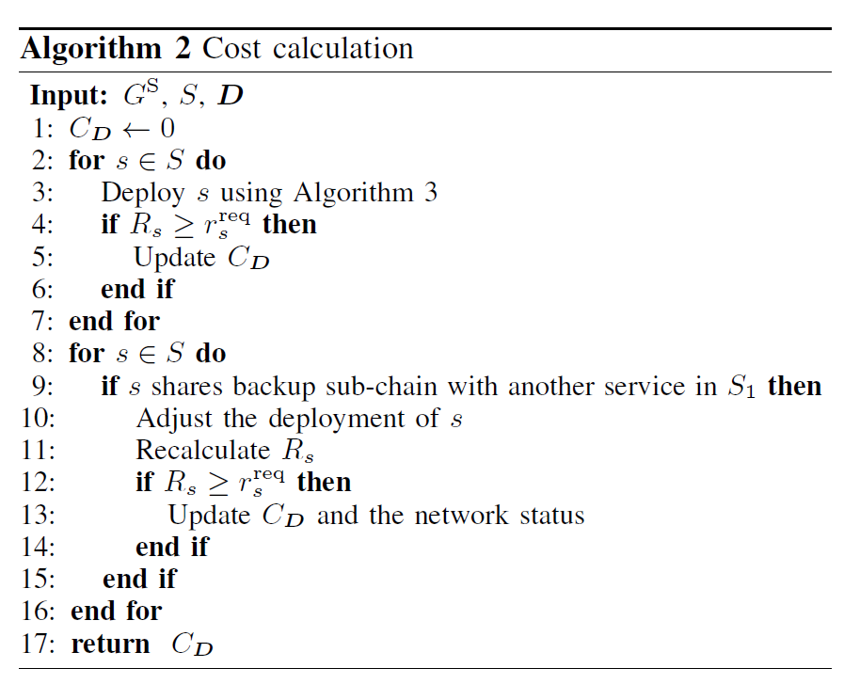
Heuristic Solution

Slide 22
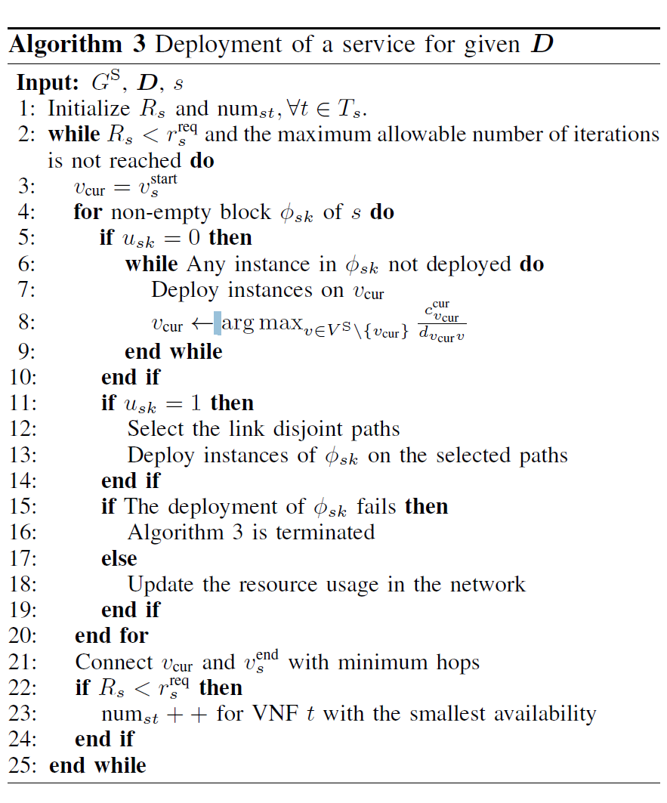
Heuristic Solution
Algorithm Calling Relationship:
Algorithm 3
Algorithm 2
Algorithm 1

Slide 23
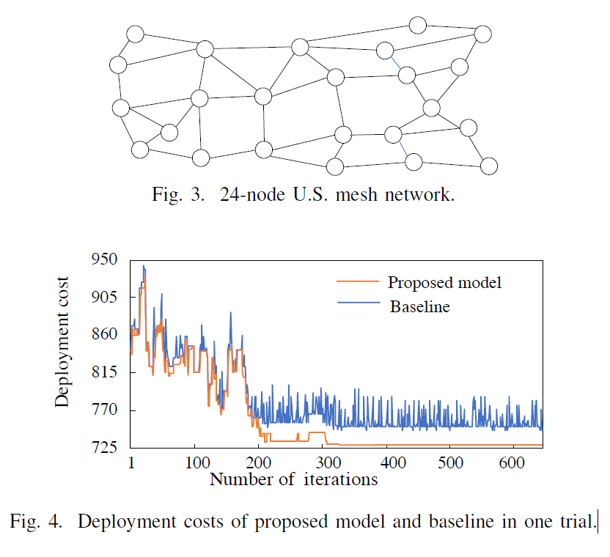
Numerical Results

Slide 24
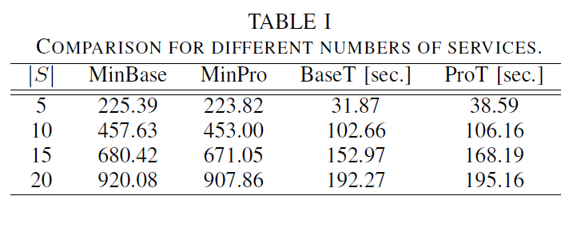
Numerical Results

Slide 25
Conclusion
This paper proposed an availability-aware service provisioning model with backup sub-chain-enabled sharing in NFV to minimize the deployment cost.
We designed a heuristic to solve it. We compared the proposed model with a baseline.
The numerical results showed that the proposed model outperforms the baseline in terms of deployment cost.

